Slide 1
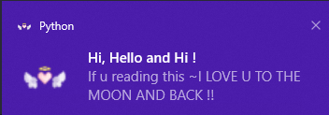
Desktop Notifier
Mitzi Rosales-Montoya
https://github.com/ksu-is/desktop-notifier

